Slide 1
Smart Security Camera
Based on a RaspberryPi
- Rohit Dhuri
Notes:
ID=d924773e-9a16-4d6d-9803-8cb819e99682 Recipe=text_billboard Type=TextOnly Variant=0 FamilyID=AccentBoxWalbaum_Zero

Slide 2
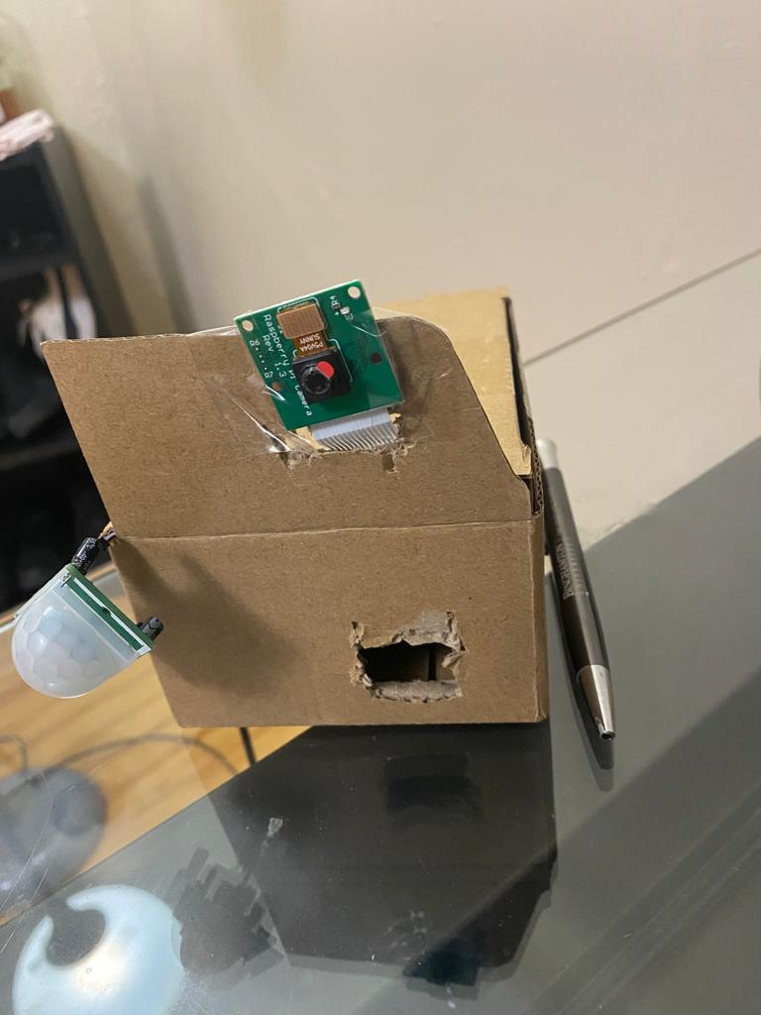
Introduction
This device can do all that a regular security camera could.
But with additional features.
Comes with an android application.
Where users can log into their account.
This device can notify the user who visited the place and when through notifications.
Live Feed.
Length (size)

Slide 3
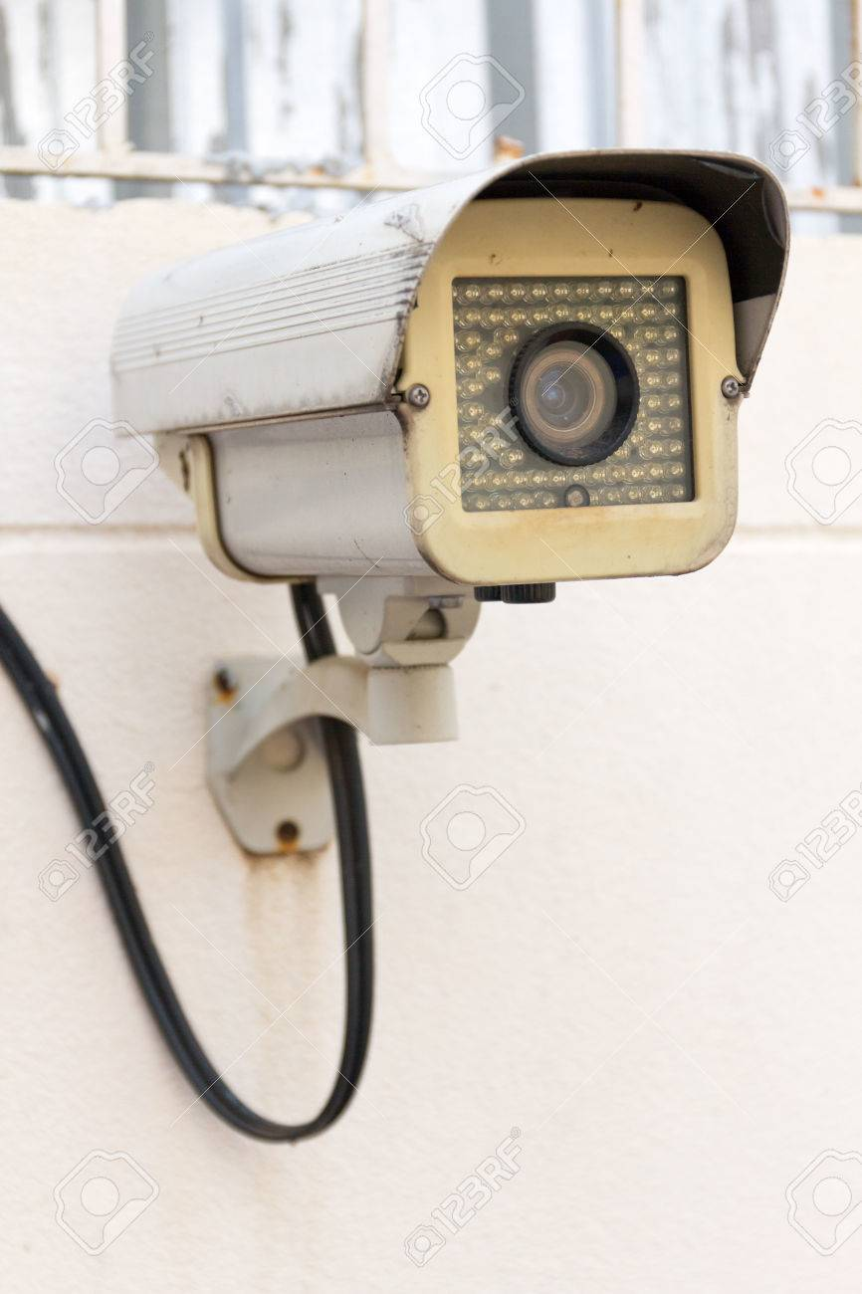
Motivation
Security cameras have proven to be excellent tools for security.
Been around since decades.
They’re expensive.
Not smart.

Slide 4
Design
Hardware
Software
RaspberryPi
Camera module
PIR motion Sensor
Breadboard
Android Studio
Python
Raspbian
Google Firebase

Slide 5
Hardware

Slide 6
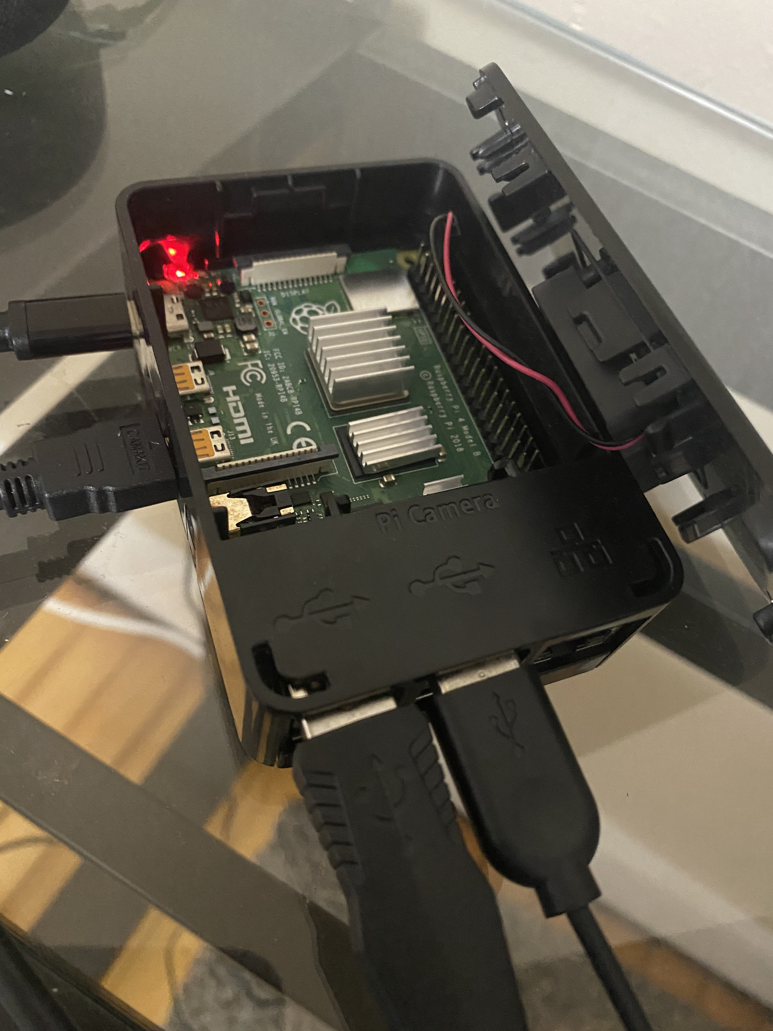
Raspberry Pi
Using Raspberry Pi 4 Model 3.

Slide 7
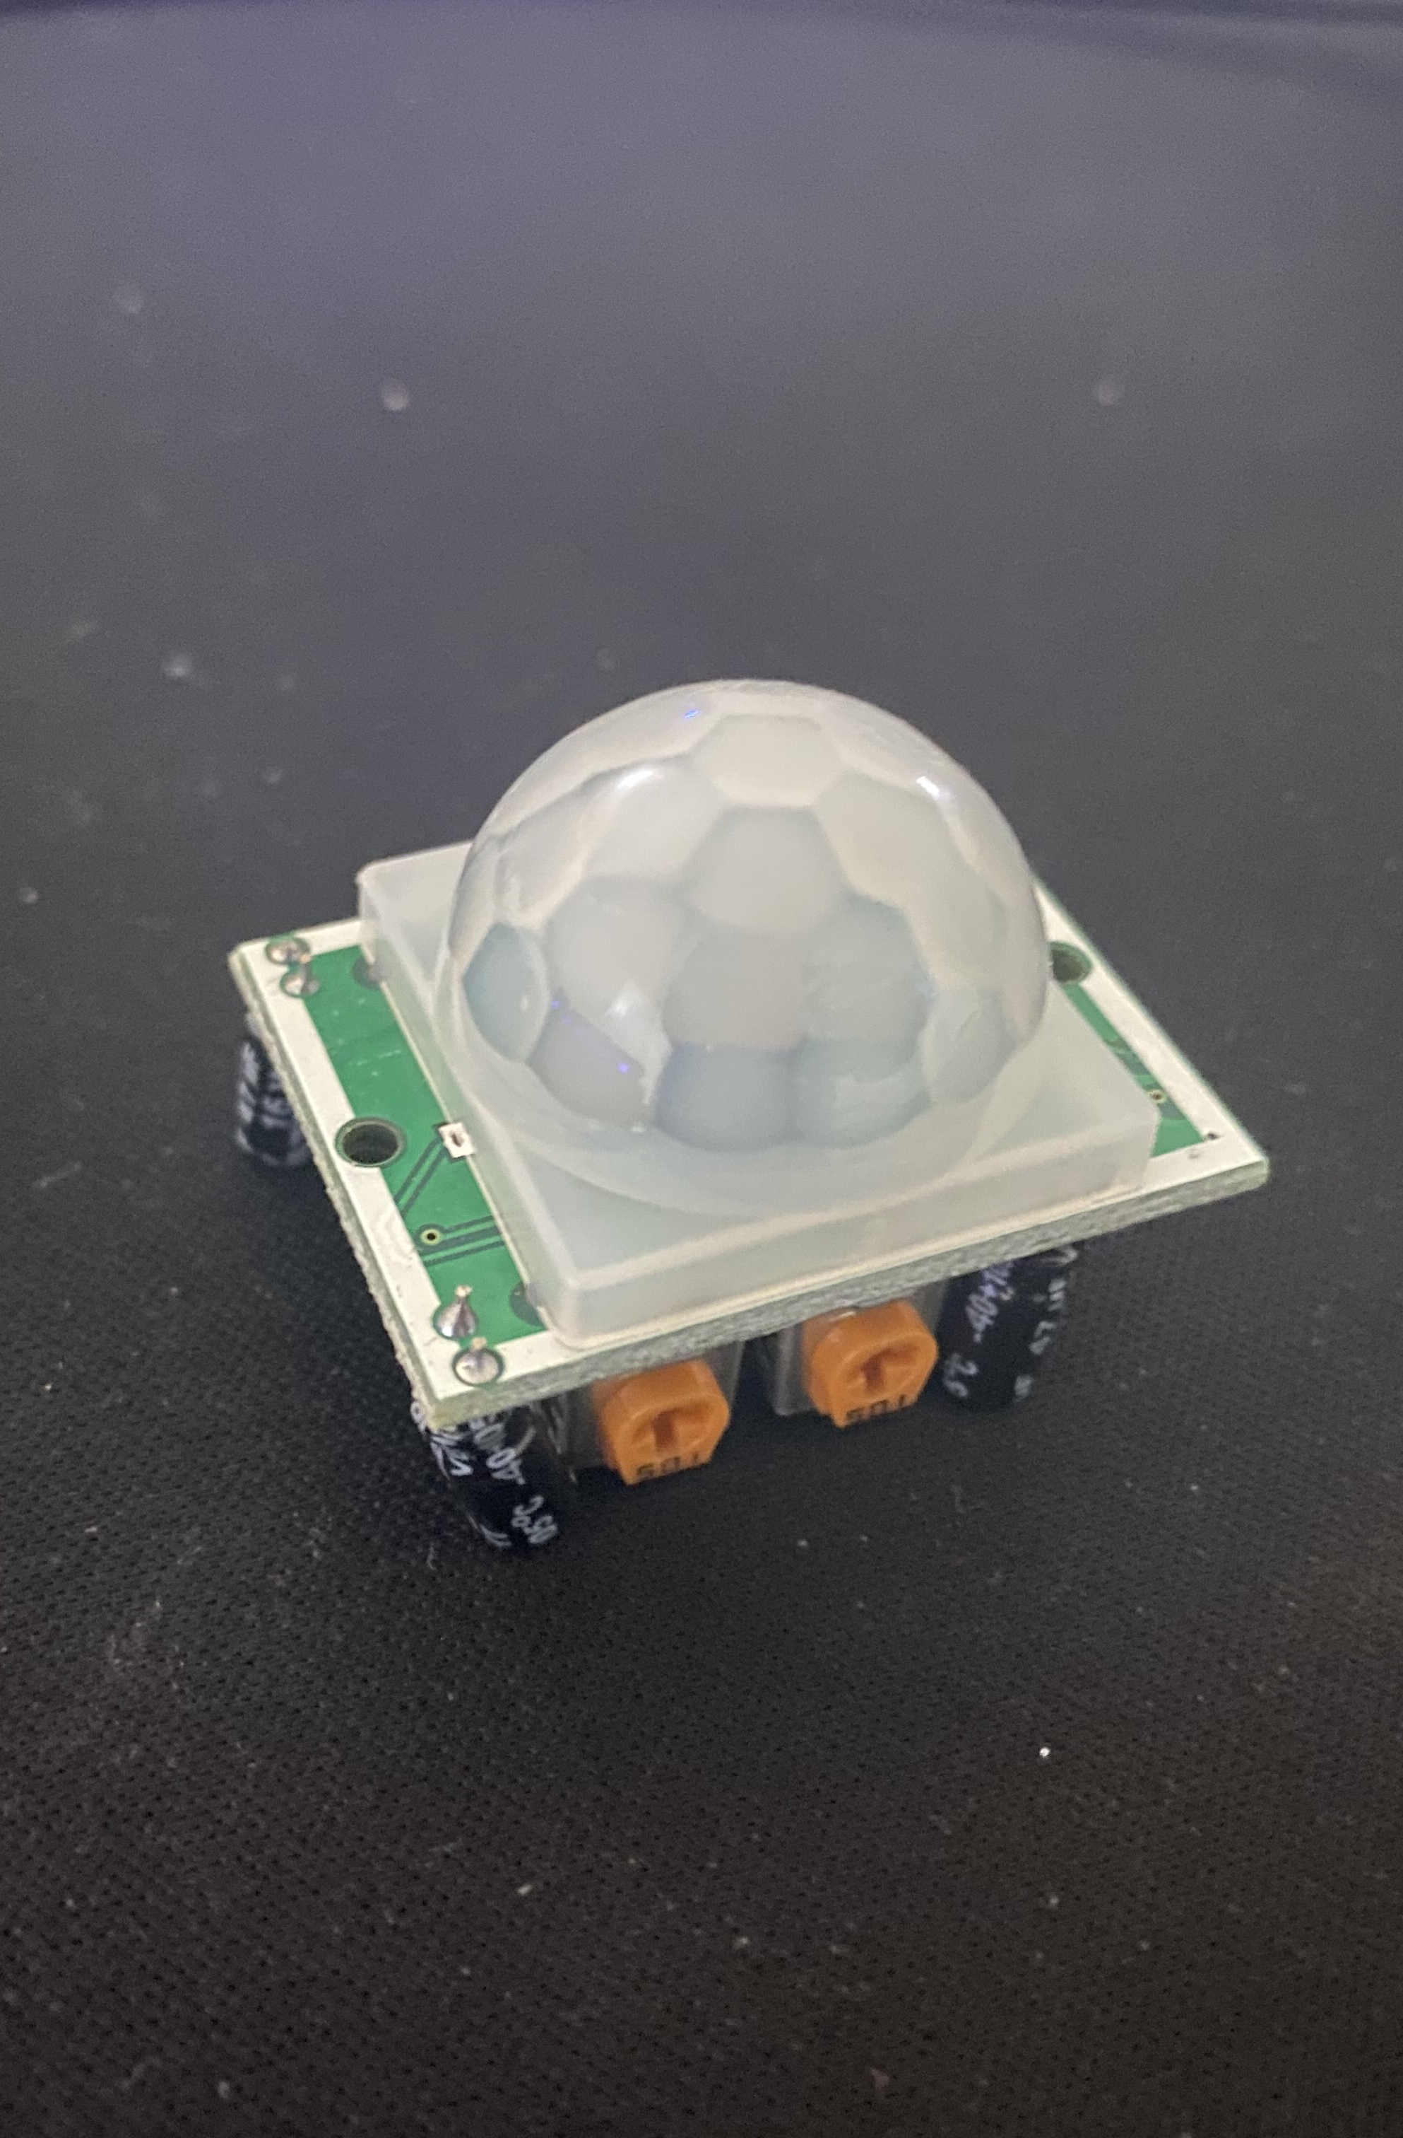
PIR motion sensor
- HC-SR501 Pyroelectric Infrared PIR Motion Sensor Detector Module.

Slide 8
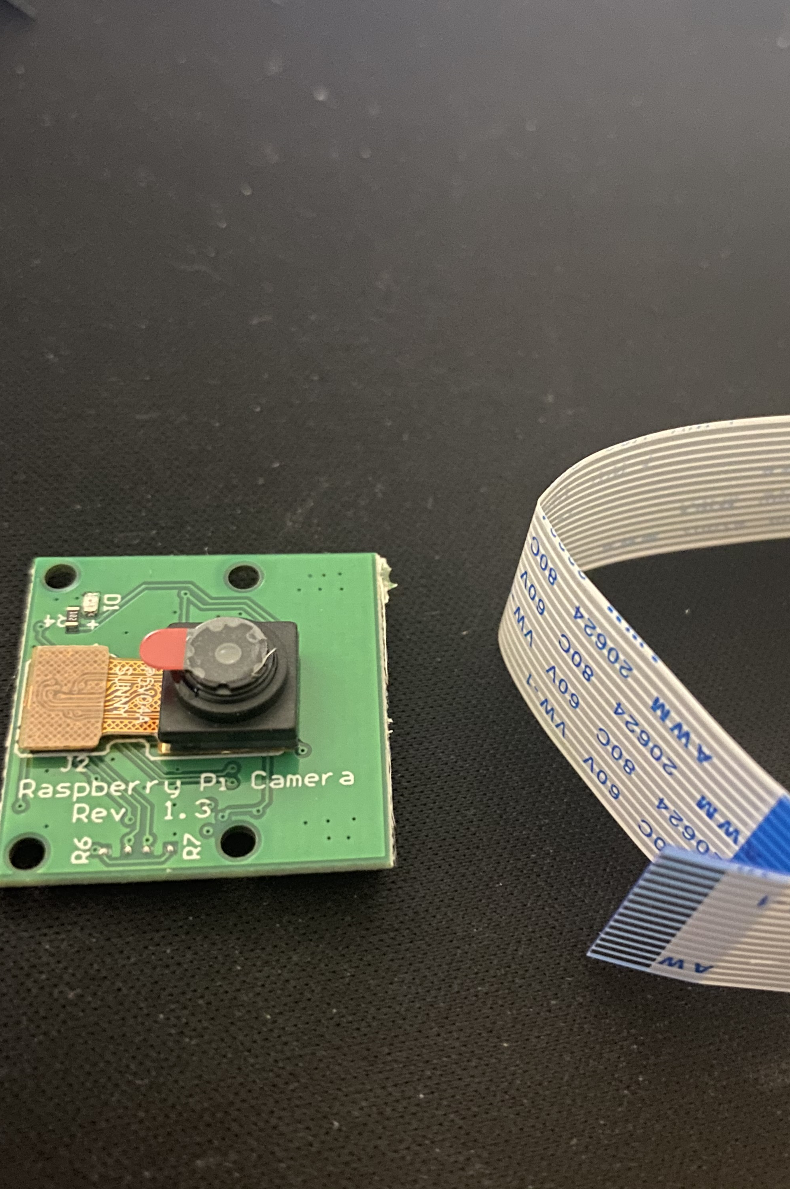
Camera Module
5 Megapixles, 1080p recording.

Slide 9
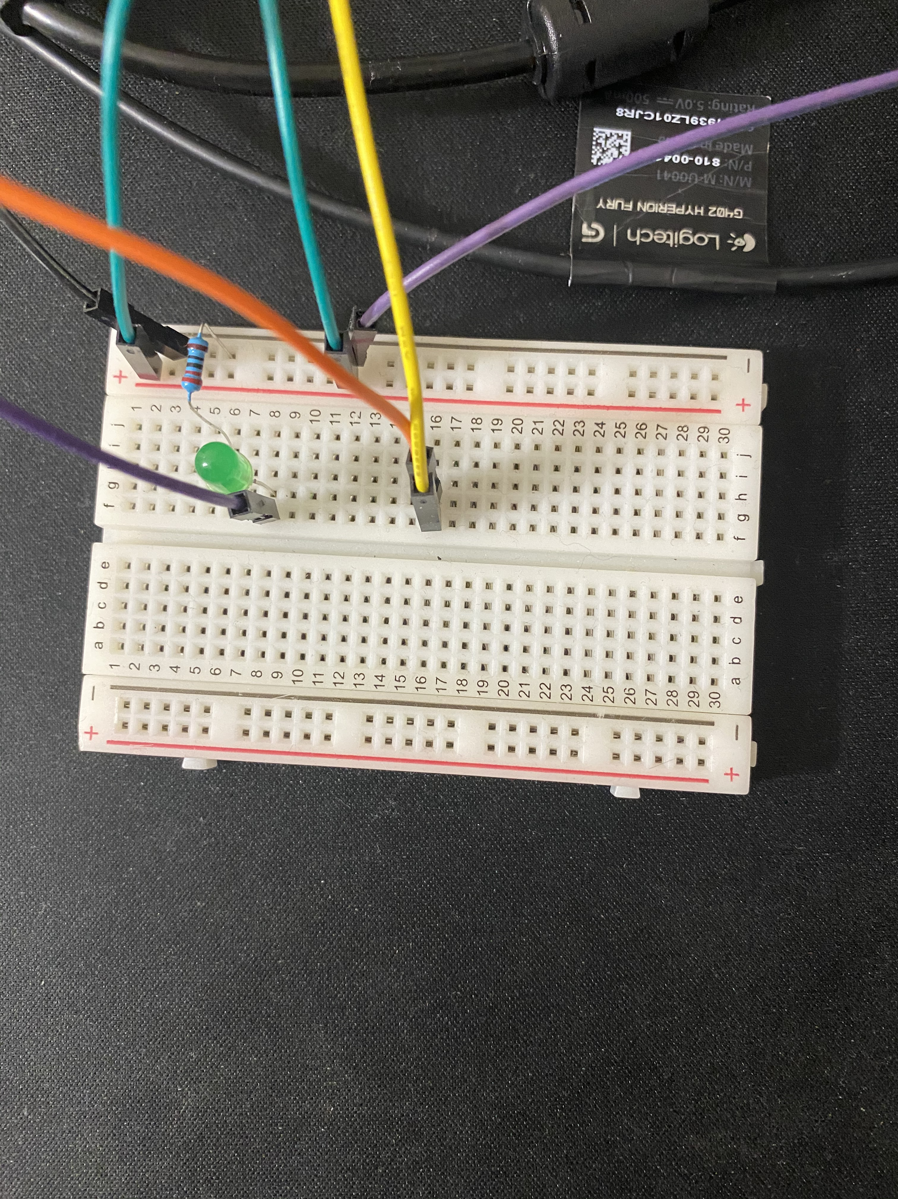
Bread Board
LED for debugging.

Slide 10
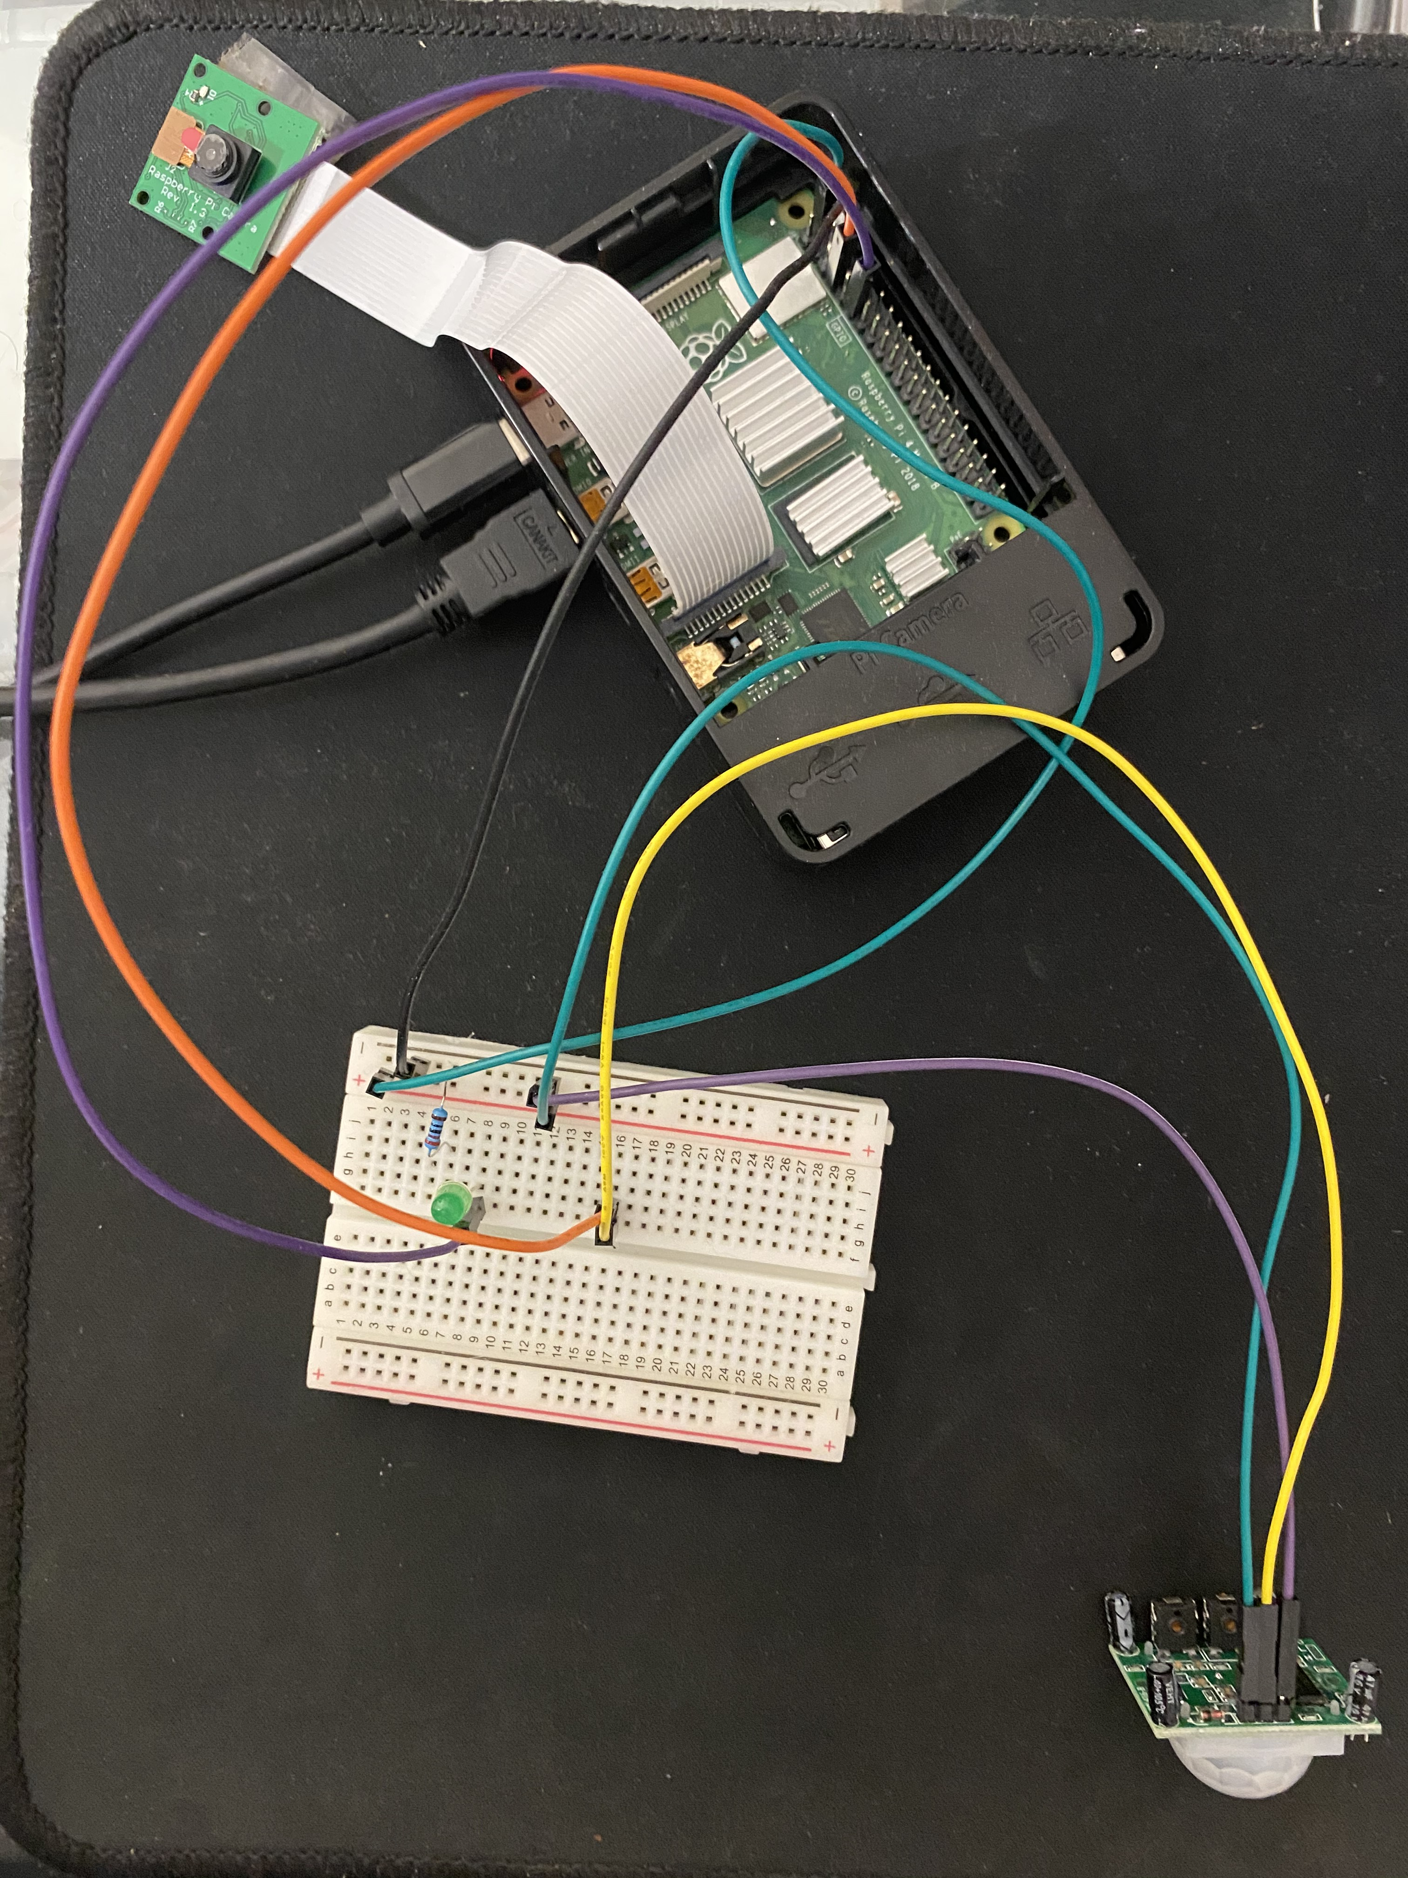
Implementation
Integration of hardware components

Slide 11
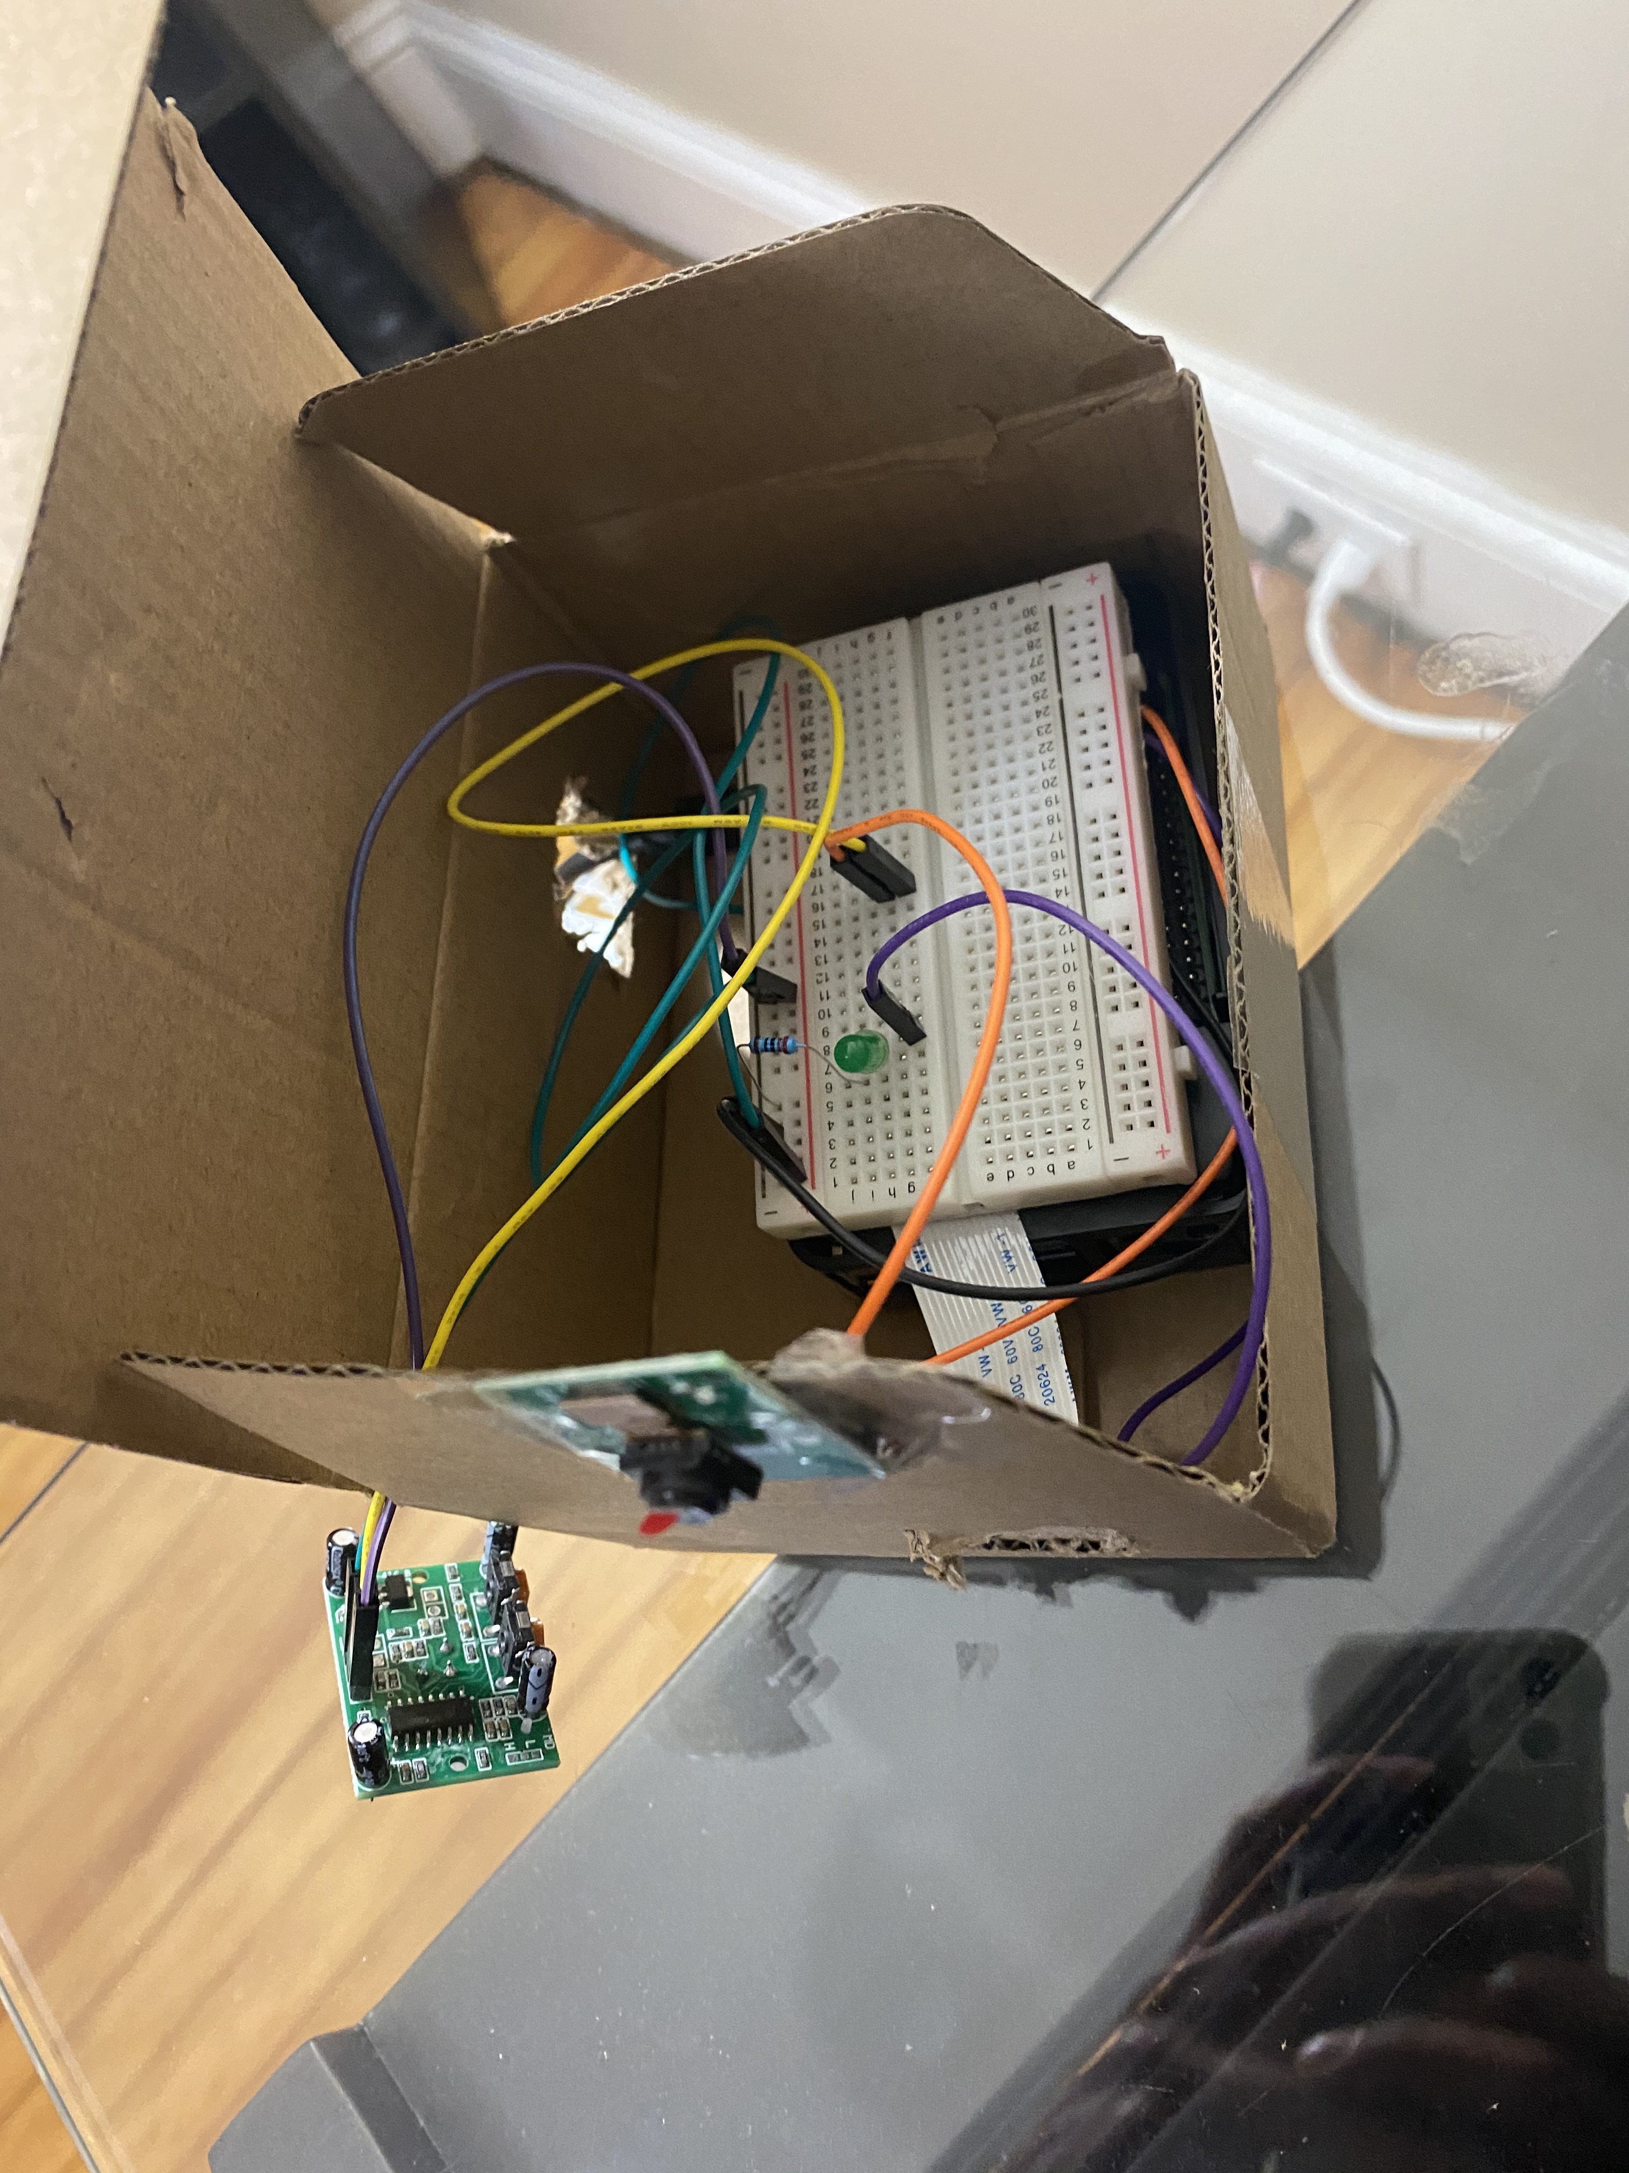
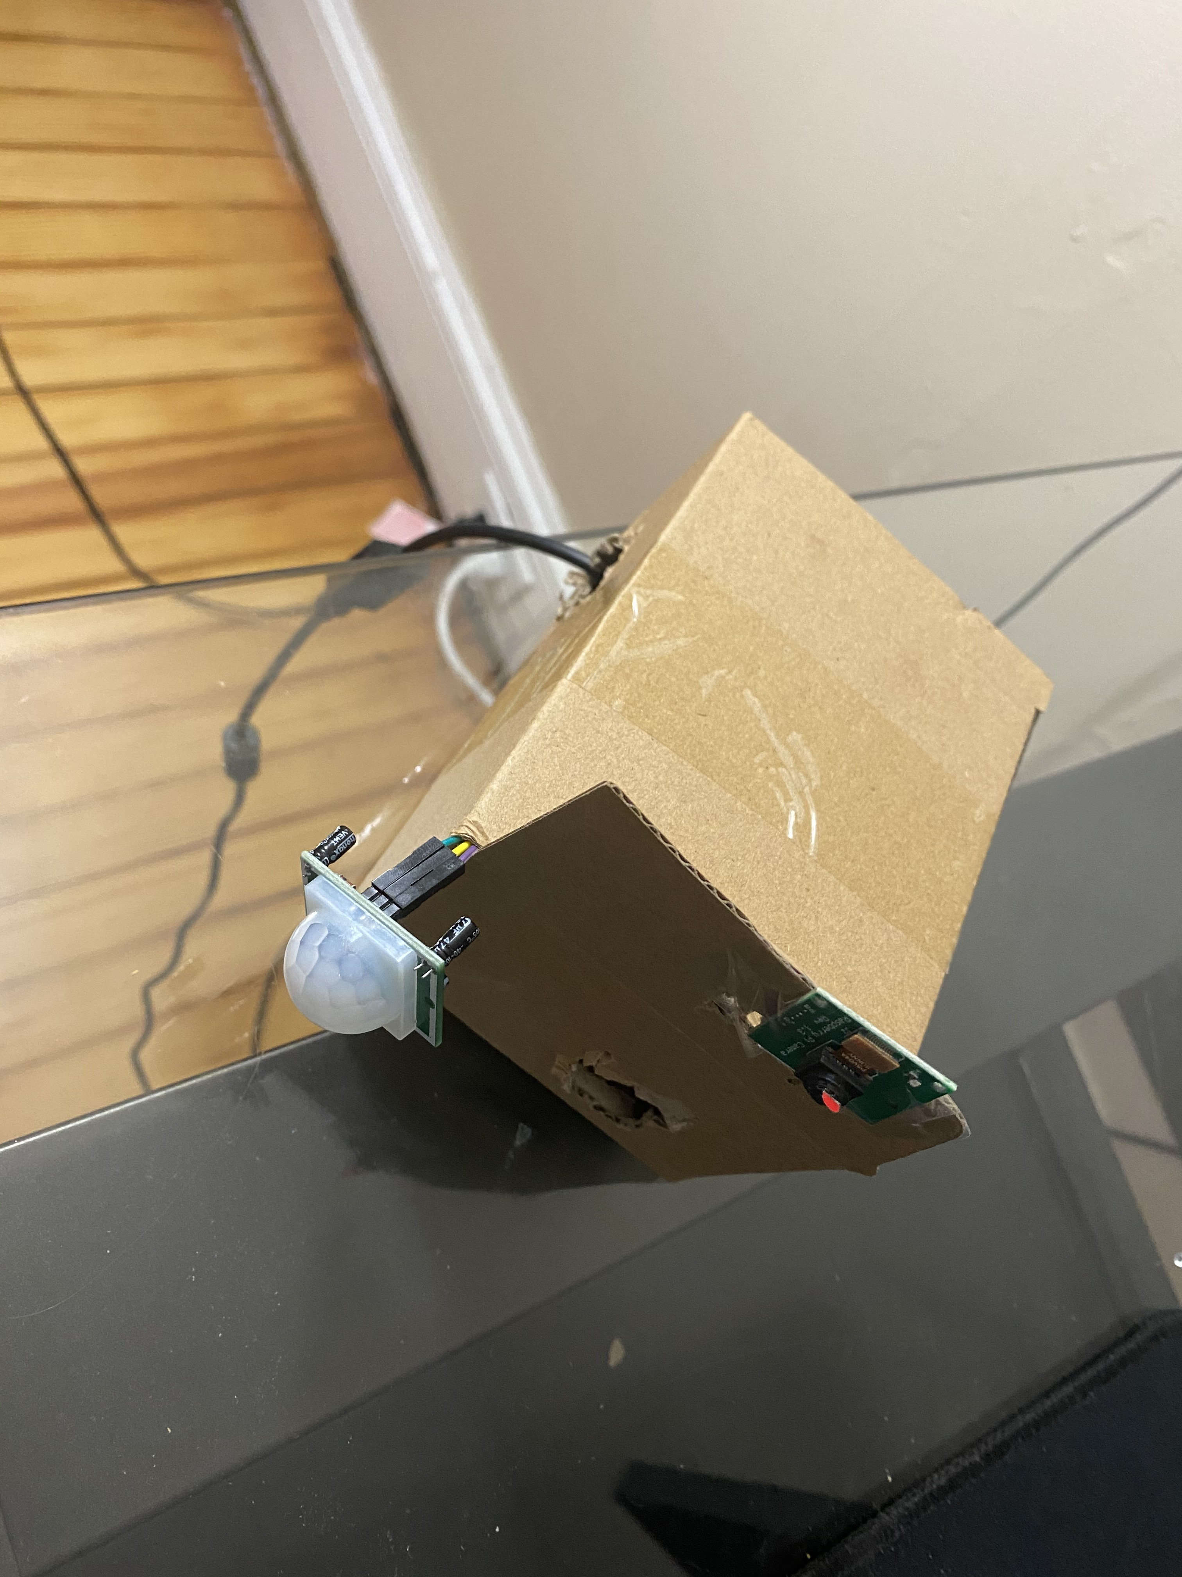
Single device

Slide 12
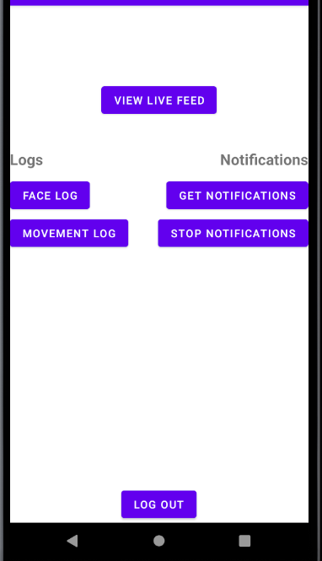
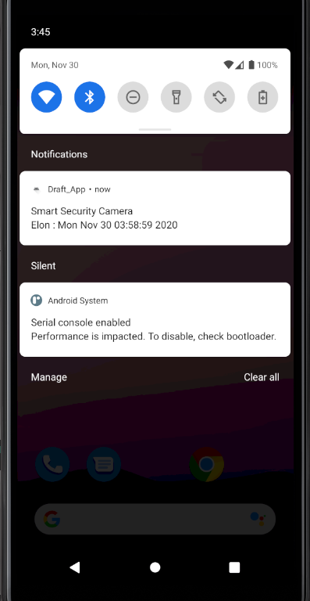
Android Application
User Registration
Logs of all activities
Instant Notifications
Logs of all Activities

Slide 13
Thank you

